Slide 1
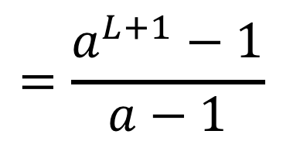
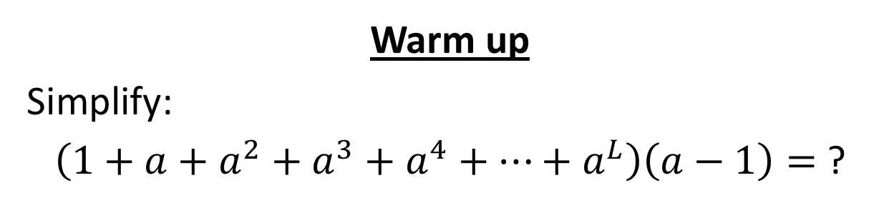
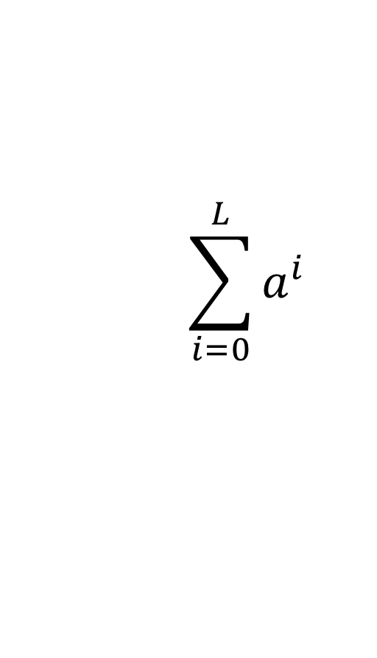
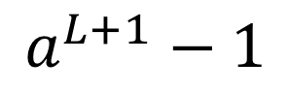
CS4102 Algorithms
Fall 2018
Warm up
Simplify:
$\left(1+a+a^{2}+a^{3}+a^{4}+…+a^{L}\right)\left(a−1\right)=$ ?
$$\left(a+a^{2}+a^{3}+a^{4}+a^{5}+…+a^{L}+a^{L+1}\right)+$$
$$\left(−a−a^{2}−a^{3}−a^{4}−a^{5}−…−a^{L}−1\right)=$$
$$a^{L+1}−1$$
$$\sum_{i=0}^{L}{a^{i}}$$
$$=\frac{a^{L+1}−1}{a−1}$$

Slide 2
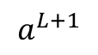
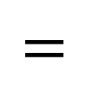
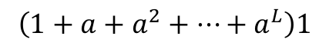
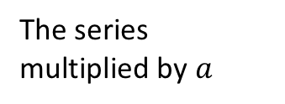
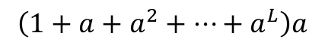
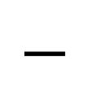
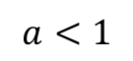
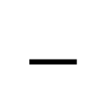
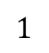
Finite Geometric Series
$$a<1$$
$$−$$
$$−$$
$$=$$
The series multiplied by $a$
The next term in the series
The series
The first term
$$\left(1+a+a^{2}+…+a^{L}\right)a$$
$$\left(1+a+a^{2}+…+a^{L}\right)1$$
$$a^{L+1}$$
$$1$$

Slide 3
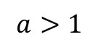
Finite Geometric Series
$$a>1$$
$$−$$
$$−$$
$$=$$
The series multiplied by $a$
The next term in the series
The series
The first term
$$\left(1+a+a^{2}+…+a^{L}\right)a$$
$$\left(1+a+a^{2}+…+a^{L}\right)1$$
$$a^{L+1}$$
$$1$$

Slide 4
Today’s Keywords
Divide and Conquer
Recurrences
Merge Sort
Karatsuba
Tree Method

Slide 5
CLRS Readings
Chapter 4

Slide 6
Homeworks
Hw0 due 11pm Wednesday, Sept 5
Submit BOTH pdf and zip!
Hw1 Due Wednesday, Sept 12
Start early!
Written (use Latex!)
Asymptotic notation
Recurrences
Divide and Conquer

Slide 8
Divide and Conquer*
Divide:
Break the problem into multiple subproblems, each smaller instances of the original
Conquer:
If the subproblems are “large”:
Solve each subproblem recursively
If the subproblems are “small”:
Solve them directly (base case)
Combine:
Merge together solutions to subproblems
*CLRS Chapter 4

Slide 9
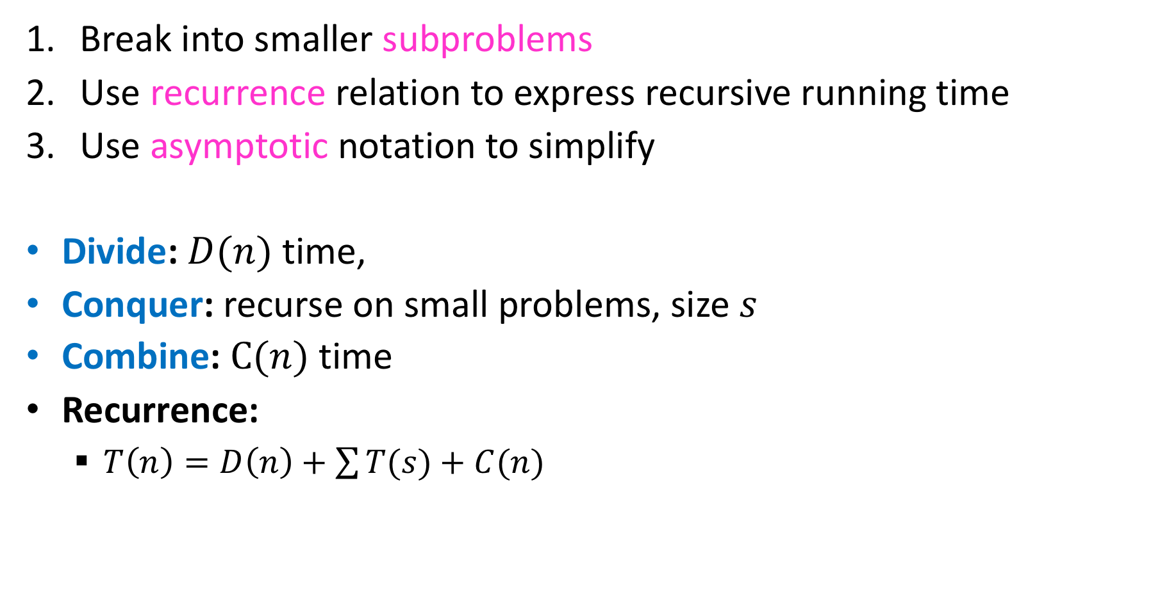
Analyzing Divide and Conquer
Break into smaller subproblems
Use recurrence relation to express recursive running time
Use asymptotic notation to simplify
Divide: $D(n)$ time,
Conquer: recurse on small problems, size $s$
Combine: $C(n)$ time
Recurrence:
$T\left(n\right)=D\left(n\right)+\sum{T(s)}+C(n)$

Slide 10


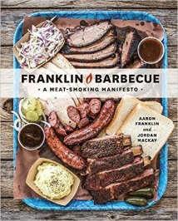
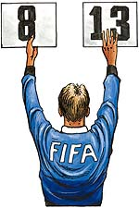
Recurrence Solving Techniques
Tree
Guess/Check
“Cookbook”
Substitution
?

Slide 11
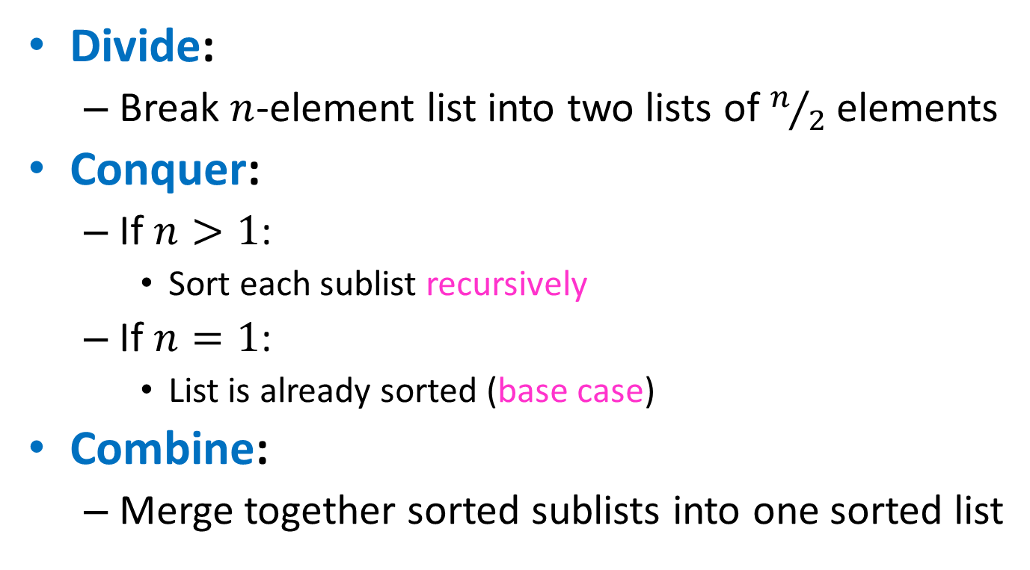
Merge Sort
Divide:
Break $n$-element list into two lists of $n/2$ elements
Conquer:
If $n>1$:
Sort each sublist recursively
If $n=1$:
List is already sorted (base case)
Combine:
Merge together sorted sublists into one sorted list

Slide 12
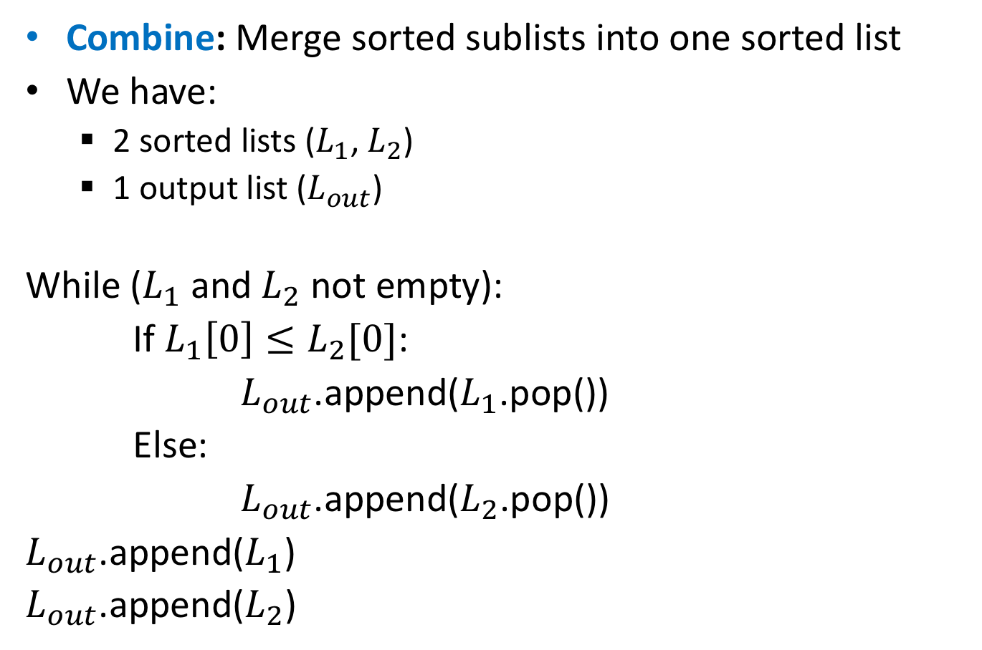
Merge
Combine: Merge sorted sublists into one sorted list
We have:
2 sorted lists ($L_{1}$, $L_{2}$)
1 output list ($L_{out}$)
While ($L_{1}$ and $L_{2}$ not empty):
If $L_{1}\left[0\right]≤L_{2}[0]$:
$L_{out}$.append($L_{1}$.pop())
Else:
$L_{out}$.append($L_{2}$.pop())
$L_{out}$.append($L_{1}$)
$L_{out}$.append($L_{2}$)

Slide 13
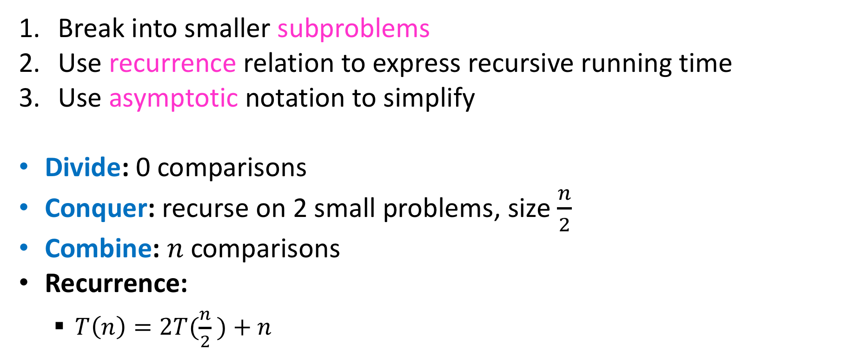
Analyzing Merge Sort
Break into smaller subproblems
Use recurrence relation to express recursive running time
Use asymptotic notation to simplify
Divide: 0 comparisons
Conquer: recurse on 2 small problems, size $\frac{n}{2}$
Combine: $n$ comparisons
Recurrence:
$T\left(n\right)=2T(\frac{n}{2} )+n$

Slide 14
Recurrence Solving Techniques
Tree
Guess/Check
“Cookbook”
Substitution
?

Slide 15
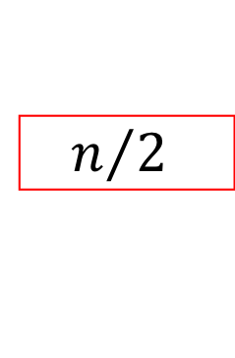
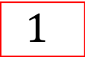
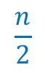
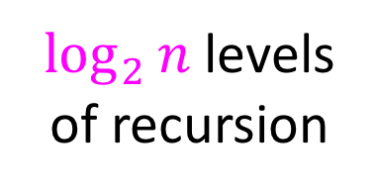
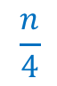

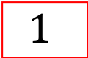
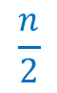
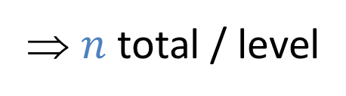
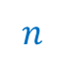
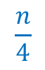
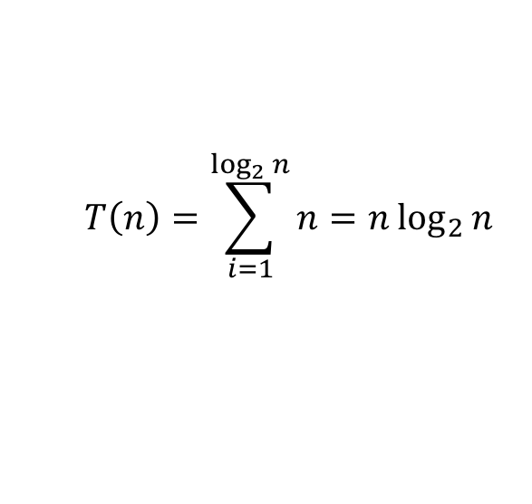
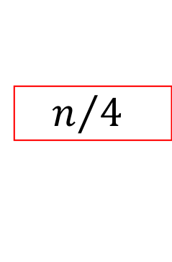
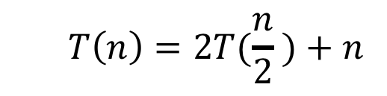



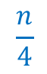




Tree method
$$T\left(n\right)=2T(\frac{n}{2} )+n$$
$$n$$
$$n$$
⇒ $n$ total / level
$$n/2$$
$$\frac{n}{2}$$
$$n/2$$
$$\frac{n}{2}$$
$$\frac{n}{4}$$
$$\frac{n}{4}$$
$$\frac{n}{4}$$
$$\frac{n}{4}$$
$\log_{2}⁡n$ levels
of recursion
$$n/4$$
$$n/4$$
$$n/4$$
$$n/4$$
…
…
…
…
…
$$1$$
$$1$$
$$1$$
$$1$$
$$1$$
$$1$$
$$1$$
$$1$$
$$1$$
$$1$$
$$1$$
$$1$$
$$T\left(n\right)=\sum_{i=1}^{\log_{2}{n}}{n}=n\log_{2}{n}$$

Slide 16
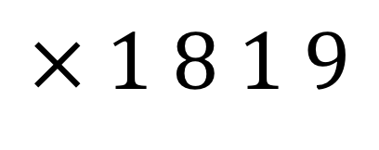
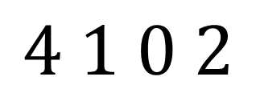

Multiplication
Want to multiply large numbers together
What makes a “good” algorithm?
How do we measure input size?
What do we “count” for run time?
$$4 1 0 2$$
$n$-digit numbers
$$× 1 8 1 9$$

Slide 17
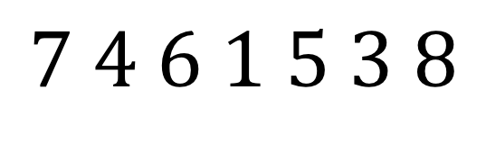

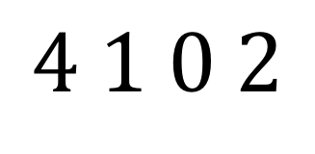

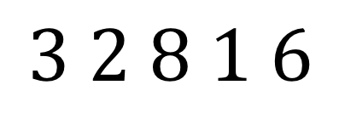

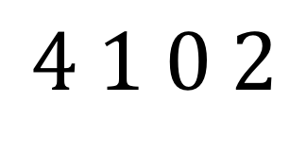
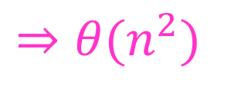
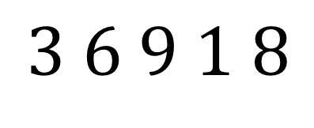


“Schoolbook” Method
How many total multiplications?
$$4 1 0 2$$
$n$-digit numbers
$$× 1 8 1 9$$
$$3 6 9 1 8$$
$n$ mults
$$4 1 0 2$$
$n$ mults
$n$ levels
$$3 2 8 1 6$$
$n$ mults
$⇒θ(n^{2})$
$$+$$
$$4 1 0 2$$
$n$ mults
$$7 4 6 1 5 3 8$$

Slide 18
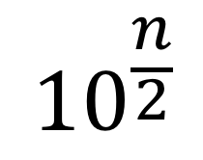
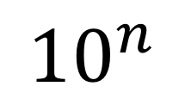
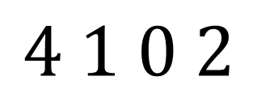

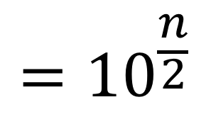

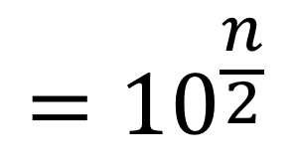

Divide and Conquer method
1. Break into smaller subproblems
$$={10}^{\frac{n}{2}}$$
$$4 1 0 2$$
a
+
b
a
b
$$={10}^{\frac{n}{2}}$$
$$× 1 8 1 9$$
+
c
d
c
d
$${10}^{n}$$
( )
+
a
$$×$$
c
$${10}^{\frac{n}{2}}$$
( )
+
a
$$×$$
d
+
b
$$×$$
c
( )
b
$$×$$
d

Slide 19
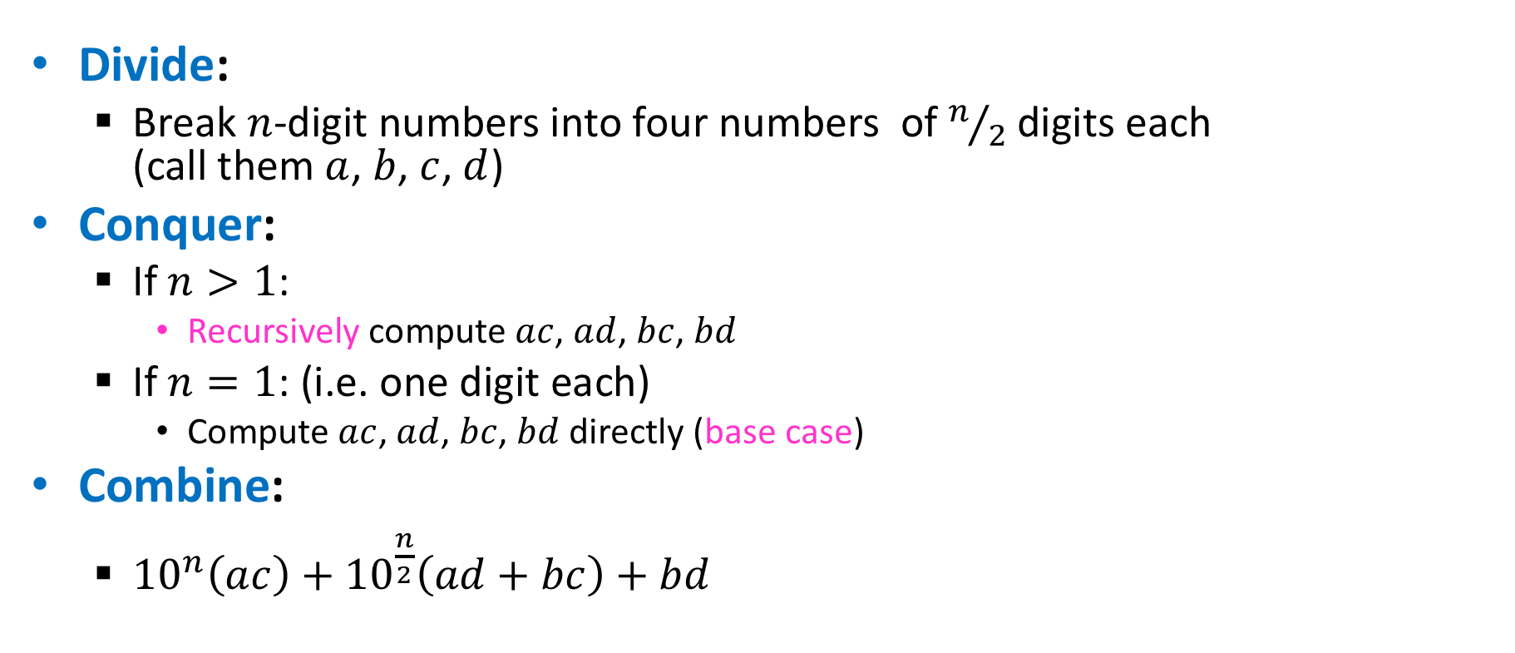
Divide and Conquer Multiplication
Divide:
Break $n$-digit numbers into four numbers of $n/2$ digits each (call them $a$, $b$, $c$, $d$)
Conquer:
If $n>1$:
Recursively compute $ac$, $ad$, $bc$, $bd$
If $n=1$: (i.e. one digit each)
Compute $ac$, $ad$, $bc$, $bd$ directly (base case)
Combine:
${10}^{n}\left(ac\right)+{10}^{\frac{n}{2}}\left(ad+bc\right)+bd$

Slide 20
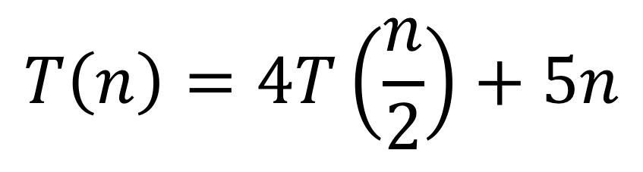
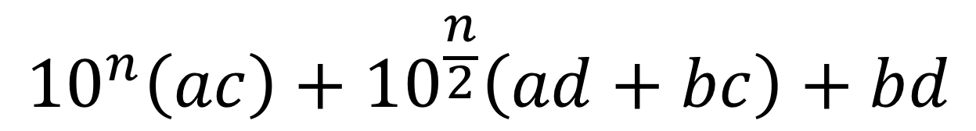
Divide and Conquer method
2. Use recurrence relation to express recursive running time
$${10}^{n}\left(ac\right)+{10}^{\frac{n}{2}}\left(ad+bc\right)+bd$$
Recursively solve
$$T\left(n\right)=4T\left(\frac{n}{2}\right)+5n$$

Slide 21

















































Divide and Conquer method
3. Use asymptotic notation to simplify
$$T\left(n\right)=5n\sum_{i=0}^{\log_{2}{n}}{2^{i}}$$
$$T\left(n\right)=4T\left(\frac{n}{2}\right)+5n$$
$$n$$
$$5n$$
$$5n$$
$$\frac{n}{2}$$
$$\frac{5n}{2}$$
$$\frac{n}{2}$$
$$\frac{5n}{2}$$
$$\frac{n}{2}$$
$$\frac{5n}{2}$$
$$\frac{n}{2}$$
$$\frac{5n}{2}$$
$$\frac{4}{2}⋅5n$$
$$\frac{n}{4}$$
$$\frac{n}{4}$$
$$\frac{n}{4}$$
$$\frac{n}{4}$$
…
$$\frac{n}{4}$$
$$\frac{n}{4}$$
$$\frac{n}{4}$$
$$\frac{n}{4}$$
$$\frac{16}{4}⋅5n$$
$$\frac{5n}{4}$$
$$\frac{5n}{4}$$
$$\frac{5n}{4}$$
$$\frac{5n}{4}$$
$$\frac{5n}{4}$$
$$\frac{5n}{4}$$
$$\frac{5n}{4}$$
$$\frac{5n}{4}$$
…
…
…
…
…
…
…
…
…
…
$$5$$
$$5$$
$$5$$
$$5$$
$$5$$
$$5$$
$$5$$
$$2^{\log_{2}{n}}⋅5n$$
$$5$$
$$5$$
$$5$$
$$5$$
$$5$$
$$5$$
$$5$$
$$1$$
$$1$$
$$1$$
$$1$$
$$1$$
$$1$$
$$1$$
$$1$$
$$1$$
$$1$$
$$1$$
$$1$$
$$1$$
$$1$$

Slide 22




Divide and Conquer method
3. Use asymptotic notation to simplify
$$T\left(n\right)=4T\left(\frac{n}{2}\right)+5n$$
$$T\left(n\right)=5n\sum_{i=0}^{\log_{2}{n}}{2^{i}}$$
$$T\left(n\right)=5n\frac{2^{\log_{2}{n}+1}−1}{2−1}$$
$$T\left(n\right)=5n(2n−1)$$
$$=Θ(n^{2})$$

Slide 23
Karatsuba
1. Break into smaller subproblems
$$={10}^{\frac{n}{2}}$$
$$4 1 0 2$$
a
+
b
a
b
$$={10}^{\frac{n}{2}}$$
$$× 1 8 1 9$$
+
c
d
c
d
$${10}^{n}$$
( )
+
a
$$×$$
c
$${10}^{\frac{n}{2}}$$
( )
+
a
$$×$$
d
+
b
$$×$$
c
( )
b
$$×$$
d

Slide 24




Karatsuba
a
b
$$×$$
c
d
$${10}^{n}\left(ac\right)+{10}^{\frac{n}{2}}\left(ad+bc\right)+bd$$
Can’t avoid these
This can be simplified
$$\left(a+b\right)\left(c+d\right)=$$
$$ac+ad+bc+bd$$
$$ad+bc=\left(a+b\right)\left(c+d\right)−ac−bd$$
Two multiplications
One multiplication

Slide 25

Karatsuba
2. Use recurrence relation to express recursive running time
$${10}^{n}\left(ac\right)+{10}^{\frac{n}{2}}\left(\left(a+b\right)\left(c+d\right)−ac−bd\right)+bd$$
Recursively solve
$$T\left(n\right)=3T\left(\frac{n}{2}\right)+8n$$

Slide 26

Karatsuba
Divide:
Break $n$-digit numbers into four numbers of $n/2$ digits each (call them $a$, $b$, $c$, $d$)
Conquer:
If $n>1$:
Recursively compute $ac$, $bd$, $\left(a+b\right)\left(c+d\right)$
If $n=1$:
Compute $ac$, $bd$, $\left(a+b\right)\left(c+d\right)$ directly (base case)
Combine:
${10}^{n}\left(ac\right)+{10}^{\frac{n}{2}}\left(\left(a+b\right)\left(c+d\right)−ac−bd\right)+bd$

Slide 27


Karatsuba Algorithm
a
b
$$×$$
c
d
Recursively compute: $ac$, $bd$, $(a+b)(c+d)$
$\left(ad+bc\right)=\left(a+b\right)\left(c+d\right)−ac−bd$
Return ${10}^{n}\left(ac\right)+{10}^{\frac{n}{2}}\left(ad+bc\right)+bd$
$$T\left(n\right)=3T\left(\frac{n}{2}\right)+8n$$
Pseudo-code
x = Karatsuba(a,c)
y = Karatsuba(a,d)
z = Karatsuba(a+b,c+d)-x-y
Return 10^{n}x +10^{n/2}z+y

Slide 28





















Karatsuba
$$T\left(n\right)=8n\sum_{i=0}^{\log_{2}{n}}{{(3/2)}^{i}}$$
3. Use asymptotic notation to simplify
$$T\left(n\right)=3T\left(\frac{n}{2}\right)+8n$$
$$n$$
$$8n$$
$$8⋅1n$$
$$\frac{n}{2}$$
$$\frac{8n}{2}$$
$$\frac{n}{2}$$
$$\frac{8n}{2}$$
$$\frac{n}{2}$$
$$\frac{8n}{2}$$
$$\frac{8}{2}⋅3n$$
$$\frac{n}{4}$$
$$\frac{n}{4}$$
$$\frac{n}{4}$$
…
$$\frac{n}{4}$$
$$\frac{n}{4}$$
$$\frac{n}{4}$$
$$\frac{8}{4}⋅9n$$
$$\frac{8n}{4}$$
$$\frac{8n}{4}$$
$$\frac{8n}{4}$$
$$\frac{8n}{4}$$
$$\frac{8n}{4}$$
$$\frac{8n}{4}$$
…
…
…
…
…
…
…
$$\frac{8}{2^{\log_{2}{n}}}⋅3^{\log_{2}{n}}n$$
…
$$8$$
$$8$$
$$8$$
$$8$$
$$8$$
$$8$$
$$8$$
$$8$$
$$8$$
$$8$$
$$1$$
$$1$$
$$1$$
$$1$$
$$1$$
$$1$$
$$1$$
$$1$$
$$1$$
$$1$$

Slide 29





Karatsuba
3. Use asymptotic notation to simplify
$$T\left(n\right)=3T\left(\frac{n}{2}\right)+8n$$
$$T\left(n\right)=8n\sum_{i=0}^{\log_{2}{n}}{{(3/2)}^{i}}$$
$$T\left(n\right)=8n\frac{{(3/2)}^{\log_{2}{n}+1}−1}{3/2−1}$$
Math, math, and more math…(on board, see lecture supplement)
$$T\left(n\right)=24\left(n^{\log_{2}{3}}\right)−16n$$
$$=Θ(n^{\log_{2}{3}})$$
$$≈Θ(n^{1.585})$$

Slide 30



$$n^{2}$$
$$n^{1.585}$$

Slide 31
Recurrence Solving Techniques
Tree
Guess/Check
“Cookbook”
Substitution
?
(induction)

Slide 32




Induction (review)
Goal: $∀k, P(k)$ holds
Base cases: $P\left(1\right)$ holds
Hypothesis: $∀n<n_{0}, P\left(n\right)$ holds
Inductive step: $P\left(n_{0}\right)⇒P\left(n_{0}+1\right)$

Slide 33




Karatsuba Guess and Check (Loose)
$$T\left(n\right)=3T\left(\frac{n}{2}\right)+8n$$
Goal: $T\left(n\right)<3000 n^{1.6}=O(n^{1.6})$
Base cases: $T\left(1\right)=8<3000$
$T\left(2\right)=3\left(8\right)+16=40<3000⋅2^{1.6}$
… up to some small $k$
Hypothesis: $∀n<n_{0} T\left(n\right)<3000n^{1.6}$
Inductive step: $T\left(n_{0}+1\right)<3000{\left(n_{0}+1\right)}^{1.6}$
see lecture supplement

Slide 34



Mergesort Guess and Check
$$T\left(n\right)=2T(\frac{n}{2} )+n$$
Goal: $T\left(n\right)<2n\log{n} =O(n\log{n})$
Base cases: $T\left(1\right)=0$
$T\left(2\right)=2<4\log{2}$
… up to some small $k$
Hypothesis: $∀n<n_{0} T\left(n\right)<n\log{n}$
Inductive step: $T\left(n_{0}+1\right)<2\left(n_{0}+1\right)\log{(n_{0}+1)}$
see lecture supplement

Slide 35

Karatsuba Guess and Check
$$T\left(n\right)=3T\left(\frac{n}{2}\right)+8n$$
Goal: $T\left(n\right)<n^{\log_{2}{3}}−16n=O(n^{\log_{2}{3}})$
Base cases: by inspection, holds for small $n$ (at home)
Hypothesis: $∀n<n_{0} T\left(n\right)<n^{\log_{2}{3}}−16n$
Inductive step: $T\left(n_{0}+1\right)<{(n_{0}+1)}^{\log_{2}{3}}−16(n_{0}+1)$
see lecture supplement

